Slide 1
Institut for Datalogi
Cassiopeia

Slide 2
Program
10.00-10.05 Velkomst
10.05-10.30 Rundvisning
10.30-10.45 Opgaver
10.45-11.00 Bo fra F-klub
11.00-11.15 Fremvisning af servere
11.15-12.30 Opgaver
12.30-13.00 MAD!!!

Slide 3
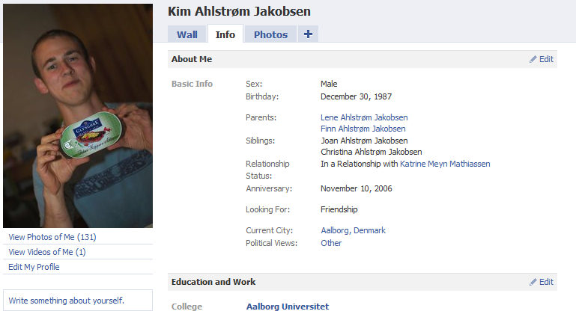
Præsentation

Slide 4
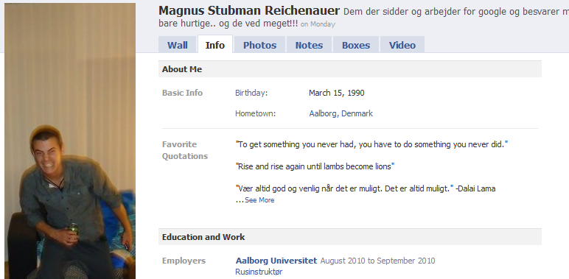
Præsentation

Slide 5

Arbejdsform
Gruppe arbejde über alles
Du er ansvarlig for din egen læring
Rapportskrivning
Frihed

Slide 6

Bachelor
Datalogi
Software
BAIT
Informatik

Slide 7

Markeds mekanismer og forretnings udvikling
Design, implementation og analysere software
Kommunikation, interaktions design og brugervenlighed

Slide 8

Systemudvikling, analyse, design
Bygge ”bro” mellem computer og bruger

Slide 9

Fokus på det teoretiske ved at programmere
Programmere med alle sprog
Optimering a kode

Slide 10

Være MONSTER god til ALT
Fokus på praktisk programmering
Programmere med alle sprog
Optimering a kode

Slide 11
10100011011000101101101010001110101401010101000110110110001111100101010010101010000111101011010001000111011101111111010101011101000010001010101011110000100010111010100011011100BINÆR_TAL111010111101110010001001111011101001011010111010101000110101010001011000001110101011000101011101010011011010101011010101010101011101010101011110100010011100100011010101010100101

Slide 12
Binære tal
10 tals systemet!
Andre talsystemer?
1024 | 512 | 256 | 128 | 64 | 32 | 16 | 8 | 4 | 2 | 1
1 | 0 | 1 | 0 | 0 | 1 | 1 | 1 | 0 | 0 | 1

Slide 13
Binære tal
1024 | 512 | 256 | 128 | 64 | 32 | 16 | 8 | 4 | 2 | 1
1 | 1 | 1 | 1 | 1 | 0 | 1 | 0 | 0 | 0 | 0
1024 | 512 | 256 | 128 | 64 | 32 | 16 | 8 | 4 | 2 | 1
1 | 1 | 1 | 1 | 0 | 1 | 1 | 0 | 0 | 0 | 1
1024 | 512 | 256 | 128 | 64 | 32 | 16 | 8 | 4 | 2 | 1
0 | 0 | 0 | 1 | 1 | 1 | 1 | 1 | 1 | 1 | 1
1024 | 512 | 256 | 128 | 64 | 32 | 16 | 8 | 4 | 2 | 1
1 | 0 | 1 | 0 | 0 | 0 | 1 | 0 | 0 | 0 | 1
1024 | 512 | 256 | 128 | 64 | 32 | 16 | 8 | 4 | 2 | 1
1 | 0 | 1 | 0 | 1 | 0 | 1 | 0 | 1 | 0 | 1
Notes:
Snak evt om Hexidicimal

Slide 14
F-klub
Bo kommer og fortæller

Slide 15
Søgning i en liste (array) Linear Search
1 | 2 | 3 | 4 | 5 | 6 | 7 | 8 | 9 | 10
4 | 9 | 11 | 16 | 19 | 26 | 31 | 49 | 51 | 67
=
>
<

Slide 16
Binary Search
1 | 2 | 3 | 4 | 5 | 6 | 7 | 8 | 9 | 10
4 | 9 | 11 | 16 | 19 | 26 | 31 | 49 | 51 | 67
min <- 1
max <- N
until (liste[mid] = x) or (min > max)
mid <- (max + min) / 2
if x > liste[mid] then
min <- mid + 1
else
max <- mid – 1
repeat

Slide 17
Binary Search
1 | 2 | 3 | 4 | 5 | 6 | 7 | 8 | 9 | 10
4 | 9 | 11 | 16 | 19 | 26 | 31 | 49 | 51 | 67
min <- 1
max <- N
until (liste[mid] = x) or (min > max)
mid <- (max + min) / 2
if x > liste[mid] then
min <- mid + 1
else
max <- mid – 1
repeat

Slide 18
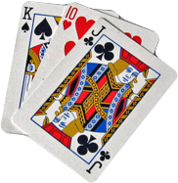
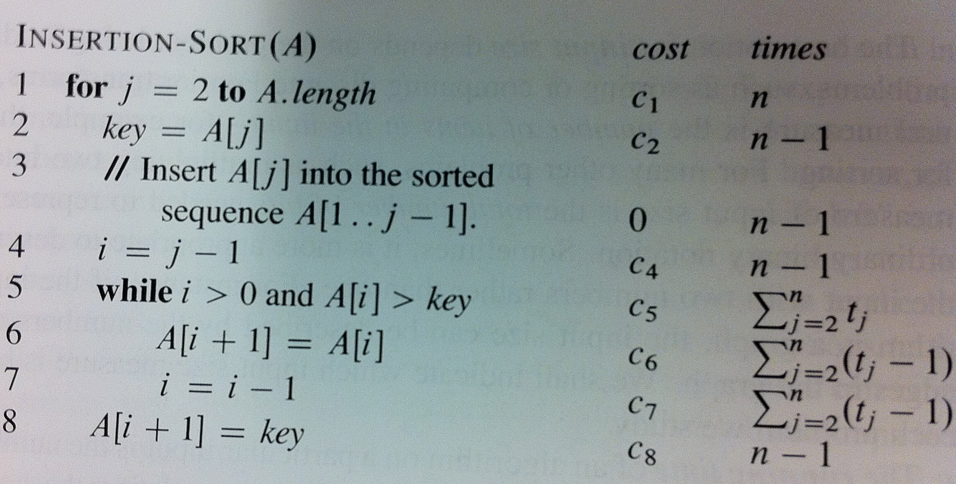
Sortering! Insertion Sort

Slide 19
Insertion sort complexity
N² bereginger
10² = 100 beregninger!!

Slide 20
Merge Sort! http://www.youtube.com/watch?v=GCae1WNvnZM
function merge_sort(m)
if length(m) ≤ 1
return m
var list left, right, result
var integer middle = length(m) /2
for each x in m up to middle
add x to left
for each x in m after middle
add x to right
left = merge_sort(left)
right = merge_sort(right)
result = merge(left, right)
return result
function merge(left,right)
var list result
while length(left) > 0 or length(right) > 0
if length(left) > 0 and length(right) > 0
if first(left) ≤ first(right)
append first(left) to result
left = rest(left)
else
append first(right) to result
right = rest(right)
else if length(left) > 0
append left to result
break
else if length(right) > 0
append right to result
break
end while
return result

Slide 21
Merge sort complexity
n*log₂(n) bereginger
10*log₂(10) = 33,219 beregninger!!

Slide 22

Professor spillet

Slide 23
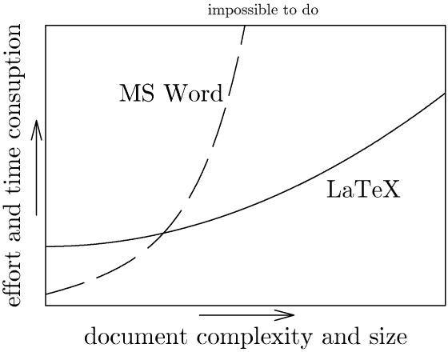
LaTeX > Word

